Slide 1

Raghu.H.V
C-DAC, Bengaluru

Slide 2

A Doubly Linked List(DLL) is a linear data structure that contains an extra pointer, typically called the previous pointer, together with the next pointer and data.

Slide 3

info: the user's data
next, prev: the address of the next and previous node in the list
.back
.info
.next

Slide 4

struct node
{
int data;
struct node *previous;
struct node *next;
}*head, *last;

Slide 5
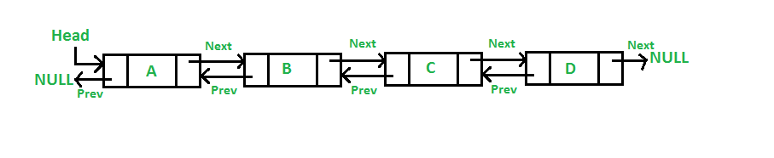

Slide 6

Singly Linked List
Doubly Linked List
Circular Linked List
Doubly Circular Linked List

Slide 7

Dynamic data structure
No Memory Wastage
Insertion and Deletion Operation are easier.

Slide 8

Memory Usage
Traversal
Reverse Traversing
Random Access

Slide 9

Reversing the doubly linked list is very easy.
It can allocate or reallocate memory easily during its execution.
The traversal of this doubly linked list is bidirectional which is not possible in a singly linked list.
Deletion of nodes is easy as compared to a Singly Linked List. A singly linked list deletion requires a pointer to the node and previous node to be deleted but in the doubly linked list, it only required the pointer which is to be deleted.

